Slide 1


Awareness is All You Need
Presentation: Yinqiao Li
Student Number: 8455569
CSIT988-Ethics and Information Security

Slide 2

Several Way to Protect InfoSec
Introduction to InfoSec: Essential Principles and Practices
Due Care & Due Diligence
Policy and Laws
Awareness: Best Method to Guarantee Infosec
CSIT988-Ethics and Information Security

Slide 3
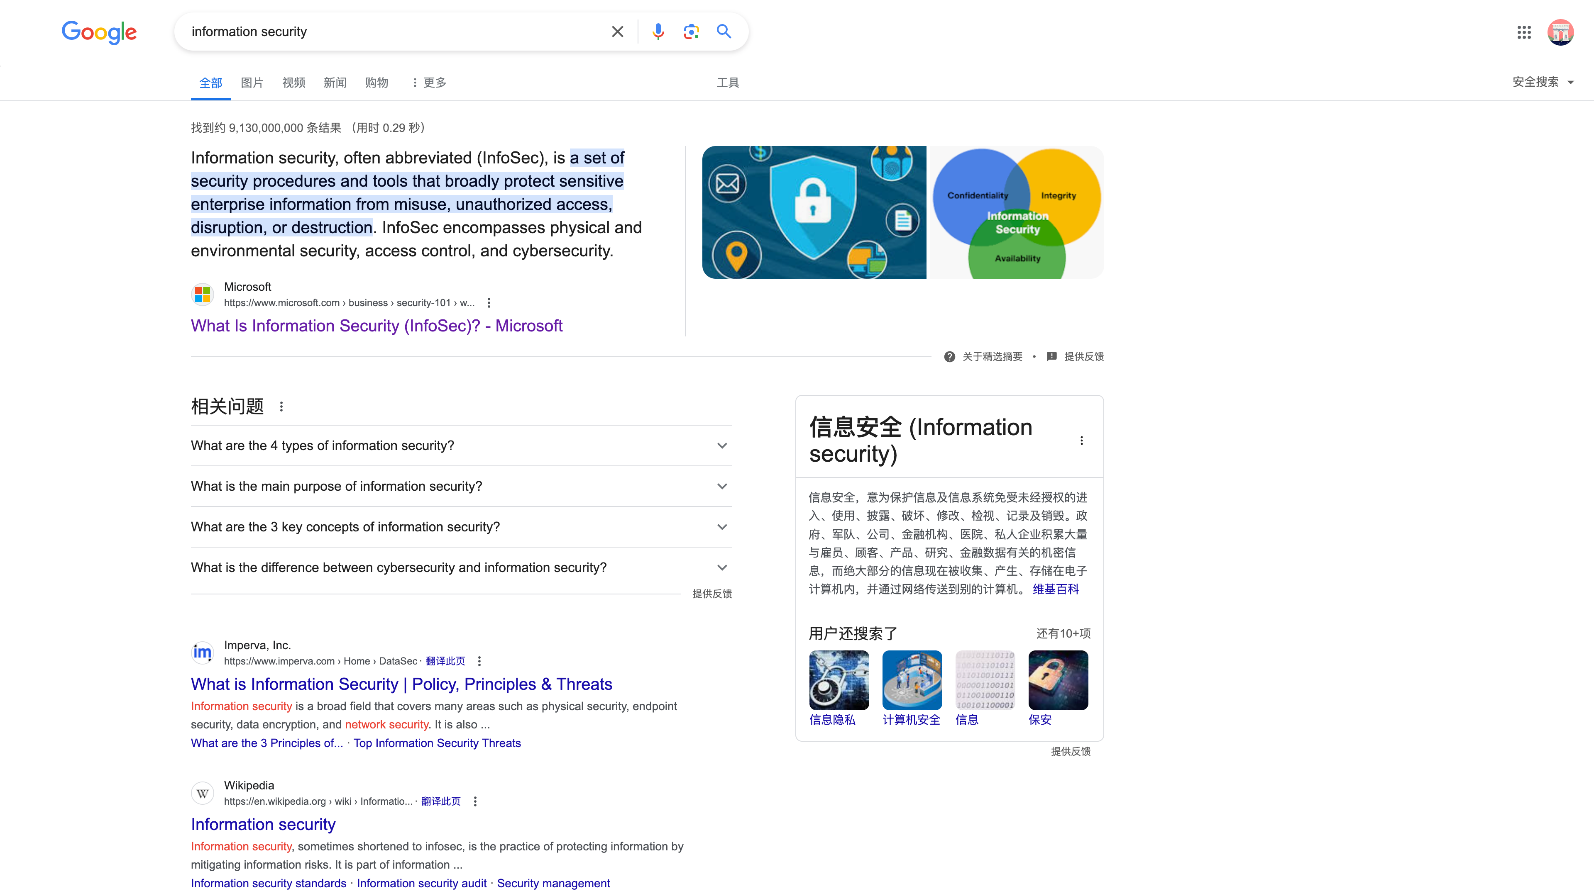
Notes:
When you type infosec in google, the first answer might me a definition by Microsoft.

Slide 4
Notes:
A set of blur blur blur…
The definition is a little abstract, right?
Let’s switch to a simple example, common in our own experience.

Slide 5
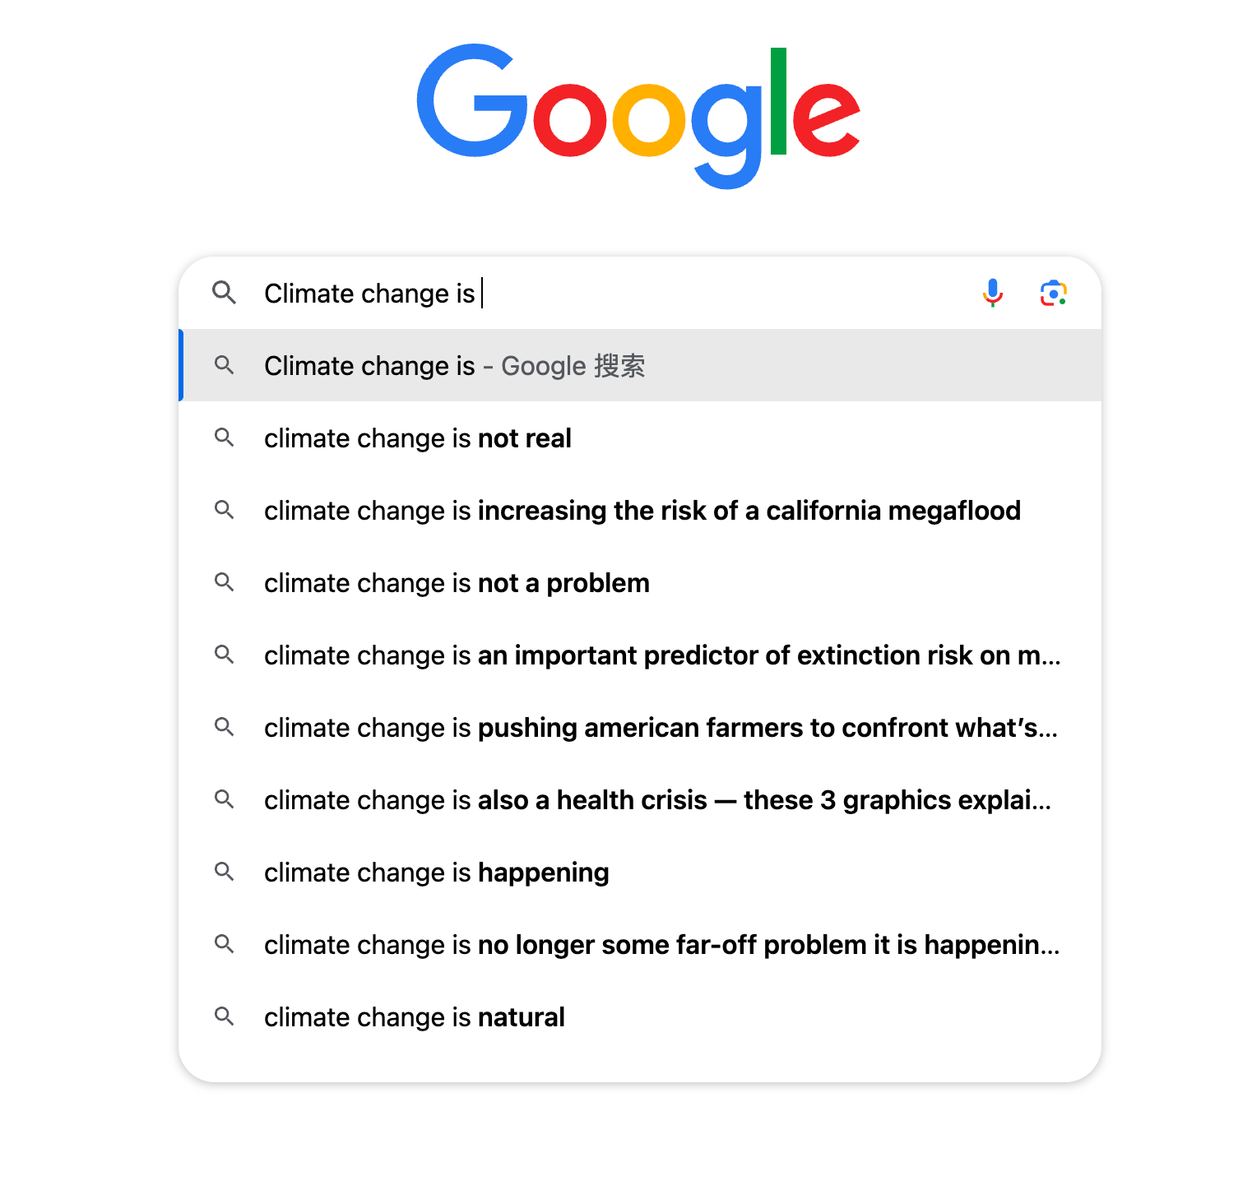
Notes:
When you go to Google and type
you are going to see different results
depending on where you live, who you are, and the particular thing google knows about your interests.

Slide 6
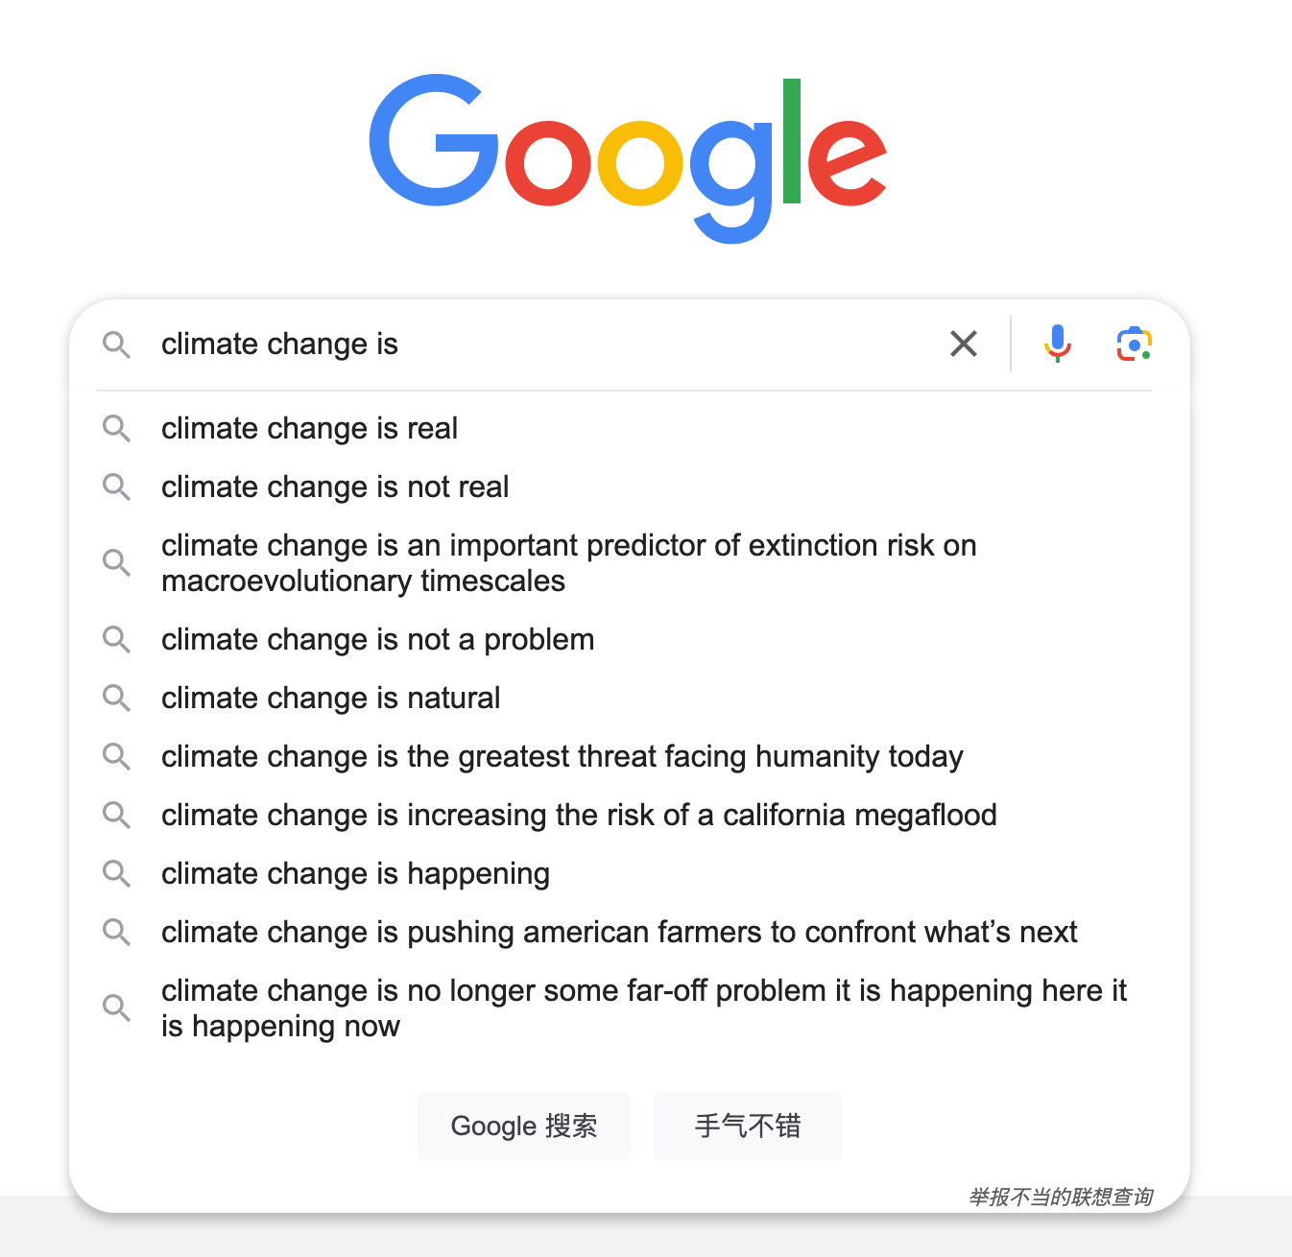
Notes:
When you go to Google and type
you are going to see different results
depending on where you live, who you are, and the particular thing google knows about your interests.

Slide 7
Notes:
That not by accident, that a design technique.
What I want to address is, whatever you do on the internet, is being watched, is being tracked.
Every single action you take, is carefully monitored, and recorded.
This kind of privacy leak is a matter of indivisuals, however, infosec is more concentrate on the benefit of large enterprice. We do not want our information to be leaked, so do them.

Slide 8
Introduction to InfoSec
Information Security Focuses on Enterprises.
CSIT988-Ethics and Information Security
Notes:
However, in the infosec field.

Slide 9
Introduction to InfoSec
Information Security Focuses on Enterprises.
Information Security safeguards business data.
CSIT988-Ethics and Information Security

Slide 10
Introduction to InfoSec
Information Security Focuses on Enterprises.
Information Security safeguards business data.
InfoSec protects against unauthorized access in enterprises.
CSIT988-Ethics and Information Security

Slide 11
Introduction to InfoSec
Information Security Focuses on Enterprises.
Information Security safeguards business data.
InfoSec protects against unauthorized access in enterprises.
Enterprise InfoSec secures cloud and endpoint information.
CSIT988-Ethics and Information Security

Slide 12
It safeguard through…
Introduction to InfoSec
Technical Tools
Access control systems, Data Loss Prevention
Policies
Regulatory Frameworks
Business Continuity and Disaster Recovery Plans
Organizational Measures
Human Factor Initiatives
Behavioral Analytics
CSIT988-Ethics and Information Security
Notes:
There are many way to guarantee infosec.

Slide 13
Due care & Due Diligence
Due Care & Due Diligence
Due Care
the level of judgment, attention, and prudence that a reasonable person would exercise.
Due Diligence
investigation or exercise of care that a reasonable business or person is expected to take (before entering into an agreement or contract with another party or an act with a certain standard of care).
CSIT988-Ethics and Information Security
Notes:
Due care and due diligence are key concepts in the field of risk management, compliance, and legal responsibility to protect infosec.

Slide 14
Comparison
Due Care & Due Diligence
Nature of Activity
Due care: doing the right thing
Due diligence: investigative process
Implementation
Due care: establishing policies and standards that are then followed
Due diligence: actions taken to confirm that the policies and standards of due care are up-to-date and that they can effectively mitigate risks
Timing
Due care: a proactive and continuous approach, continuity.
Due diligence: assessment before a commitment is made, incontinuity.
CSIT988-Ethics and Information Security
Notes:
Now we will analyze the difference between them in 3 aspects.

Slide 15
Two Questions
Due Care & Due Diligence
Why should an organization make sure to exercise due care in its usual course of operation?
Why due care and due diligence are both important?
CSIT988-Ethics and Information Security
Notes:
Here I want to give two short answers towards this two Question in the assignment tasks.

Slide 16
Due Care & Due Diligence
Why should an organization make sure to exercise due care in its usual course of operation?
Due care: Continuity
Marko Niemimaa. Information systems continuity process: Conceptual founda- tions for the study of the “social”. Computers & Security, 65:1–13, 2017.
CSIT988-Ethics and Information Security
Notes:
In the actual IT indus- try, whether it’s technology, products, or equipment, everything is constantly being updated, and inevitably, there are threats to information security.
Marko concluded that the necessity of continuous due care in Infosec is based on conceptual foundations for IS continuity.
They pointed out several reasons an organization should make sure to exercise due care in its usual course of operatio

Slide 17
Due Care & Due Diligence
Why due care and due diligence are both important?
1.Voluntary commitments is pale.
2. Due diligence is a necessary complement to due care.
Jorge Sellare, Jan Börner, Fritz Brugger, Rachael Garrett, Isabel Günther, Eva- Marie Meemken, and David Wuep- per. Six research priorities to support corporate due-diligence policies. Nature, 606(7916):861–863, 2022.
CSIT988-Ethics and Information Security
Notes:
Due care and due diligence are key concepts in the field of risk management, compliance, and legal responsibility.
Garrett, R. D. et al. find voluntary commitment dedicated to due diligence had been proven ineffectual
The emergence of multiple ethical issues indicates that relying solely on voluntary commitments to resist unethical behavior is pale.
So the investigation from a third party is necessary.
Thus they two are complementary.

Slide 18
Policy & Laws
Policy & Laws
Internal guidelines
Organizational rules
External guidelines
Governmental rules
CSIT988-Ethics and Information Security
Notes:
Policy and Laws establish the foundation of infosec in a ground aspect.

Slide 19
Policy & Laws
Policy & Laws
Internal guidelines
Organizational rules
Guidelines
External guidelines
Governmental rules
Deterrence
CSIT988-Ethics and Information Security
Notes:
Policy is more like guideline and laws are more like deterrence.

Slide 20
Crete-Nishihata et al. Law enforcement training is effective. Policies can be implemented only under legal system.
Policy & Laws
Masashi Crete-Nishihata, Joshua Oliver, Christopher Parsons, Dawn Walker, Lokman Tsui, and Ronald Deibert. The information security cultures of jour- nalism. Digital Journalism, 8(8):1068–1091, 2020.
CSIT988-Ethics and Information Security
Notes:
Crete-Nishihata et al. conducted a study on the effectiveness of law enforcement training and found that law enforcement training is effective in reducing the number of illegal activities. Policies can be effectively implemented only under a legal and regulatory system with complete mandatory effect.

Slide 21
Policy and Laws work.
Policy & Laws
CSIT988-Ethics and Information Security

Slide 22
Policy and Laws work. But there is a better approach.
Policy & Laws
CSIT988-Ethics and Information Security

Slide 23
Kitsios et al. Study on the implementation of International Organization for Standardization 270000: Risks are undetected and overlooked.
Awareness
Fotis Kitsios, Elpiniki Chatzidimitriou, and Maria Kamariotou. The iso/iec 27001 information security management standard: how to extract value from data in the it sector. Sustainability, 15(7):5828, 2023.
CSIT988-Ethics and Information Security
Notes:
Kitsios et al. conducted a study on a program implemented in the information technology sector to ensure compliance with the International Organization for Standardization 27000. However, the authors found that a significant portion of risks went undetected and were overlooked after the company adopted these standards. The rapid expansion and iteration of company operations and technology demonstrated that a static and uniform security model is insufficient for modern information security needs

Slide 24
Mikko et al. Social influence Awareness is the KEY.
Awareness
Mikko Siponen, Seppo Pahnila, and M Adam Mahmood. Compliance with information security policies: An empirical investigation. Computer, 43(2):64–71, 2010.
CSIT988-Ethics and Information Security
Notes:
Differing from the focus on law and policy implementation emphasized by other researchers, Mikko et al. observed an inspiring phenomenon: social influence, particularly the culture of compliance within a company, has a significant and positive impact on employees’ adherence to information security practices. Drawing from their findings, awareness is key. The authors suggest that managers must guar- antee the enlightening of personnel regarding cybersecurity dangers, their potential impact, and the swiftness with which these threats can proliferate within the enterprise[7].

Slide 25
Mikko et al. Social influence Awareness is the KEY. Technology is always developing. Perfection in systems does not exist. Awareness works on guaranteeing Infosec.
Awareness
Mikko Siponen, Seppo Pahnila, and M Adam Mahmood. Compliance with information security policies: An empirical investigation. Computer, 43(2):64–71, 2010.
CSIT988-Ethics and Information Security
Notes:
Differing from the focus on law and policy implementation emphasized by other researchers
Mikko et al. observed an inspiring phenomenon: social influence, particularly the culture of compliance within a company, has a significant and positive impact on employees’ adherence to information security practices. Drawing from their findings, awareness is key. The authors suggest that managers must guar-antee the enlightening of personnel regarding cybersecurity dangers, their potential impact, and the swiftness with which these threats can proliferate within the enterprise[7].

Slide 26
Awareness works on guaranteeing Infosec. Continuous training and supervision of employees. Consciousness plays a role.
Awareness
Mikko Siponen, Seppo Pahnila, and M Adam Mahmood. Compliance with information security policies: An empirical investigation. Computer, 43(2):64–71, 2010.
CSIT988-Ethics and Information Security
Notes:
what this article wants to emphasize here is that the role of continuous training and supervision of employees in the daily operations of companies and organizations has been underestimated in terms of enhancing employee awareness of information security, standardizing operations, and avoiding unetical behaviour.
As previously mentioned, awareness is the key. Consciousness plays a strong role in the restraint and regulation of operations.

